Slide 1
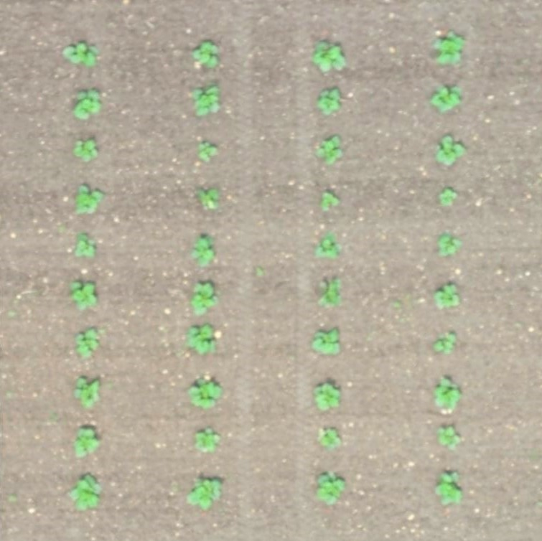
Plant Area

Slide 2
ROW
ROW
ROW
ROW
Spacing Dimension

Slide 3
ROW
ROW
ROW
ROW
Between Row

Slide 4
ROW
ROW
ROW
ROW
In Row

Slide 5

Diameter

Slide 6
Length

Slide 7
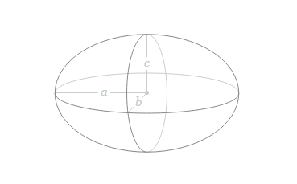
Volume

